Slide 1
Contact me
Kate Donovan
bvveggiegardens@gmail.com
Blackstonevalleyveggiegardens.com

Slide 2
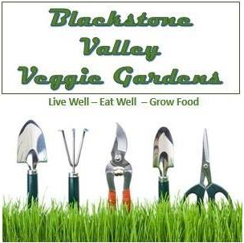
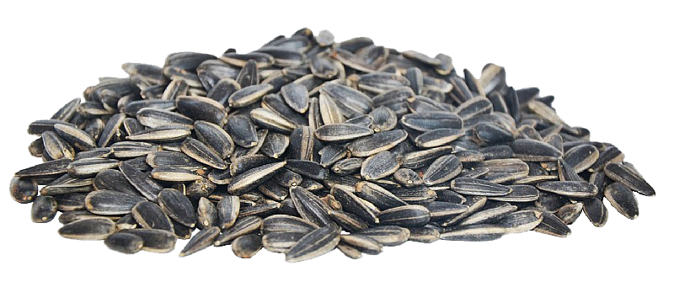
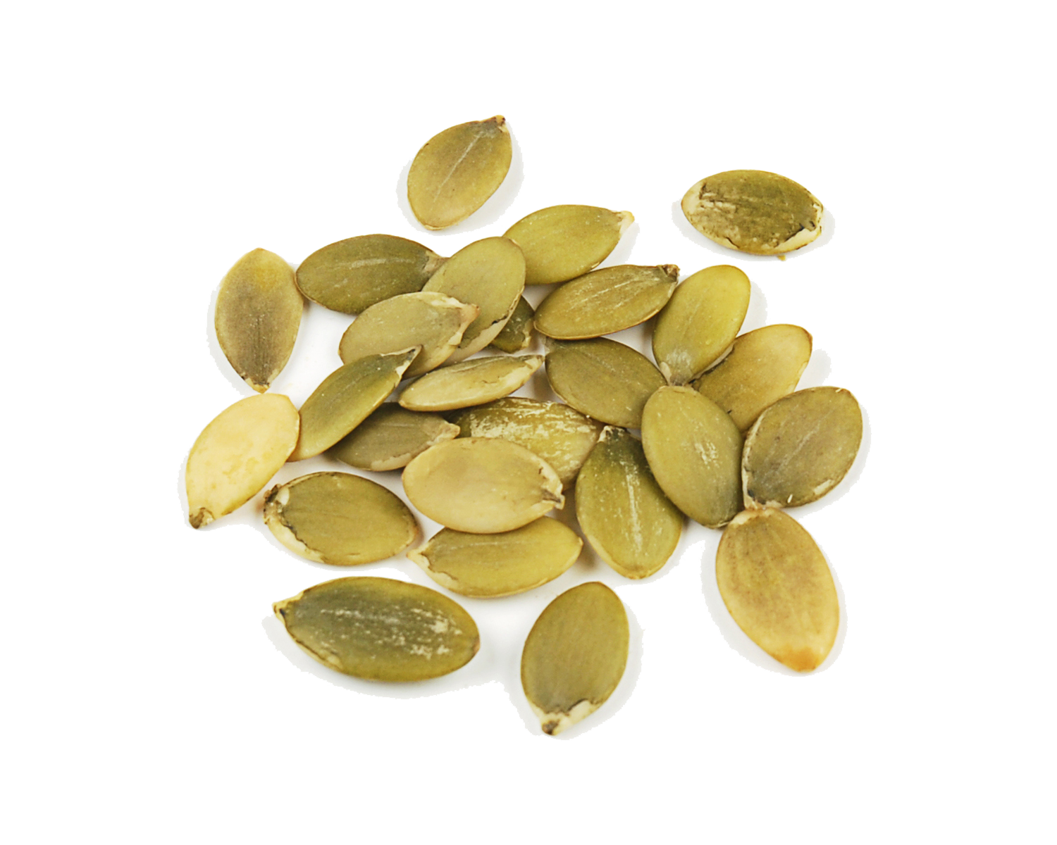
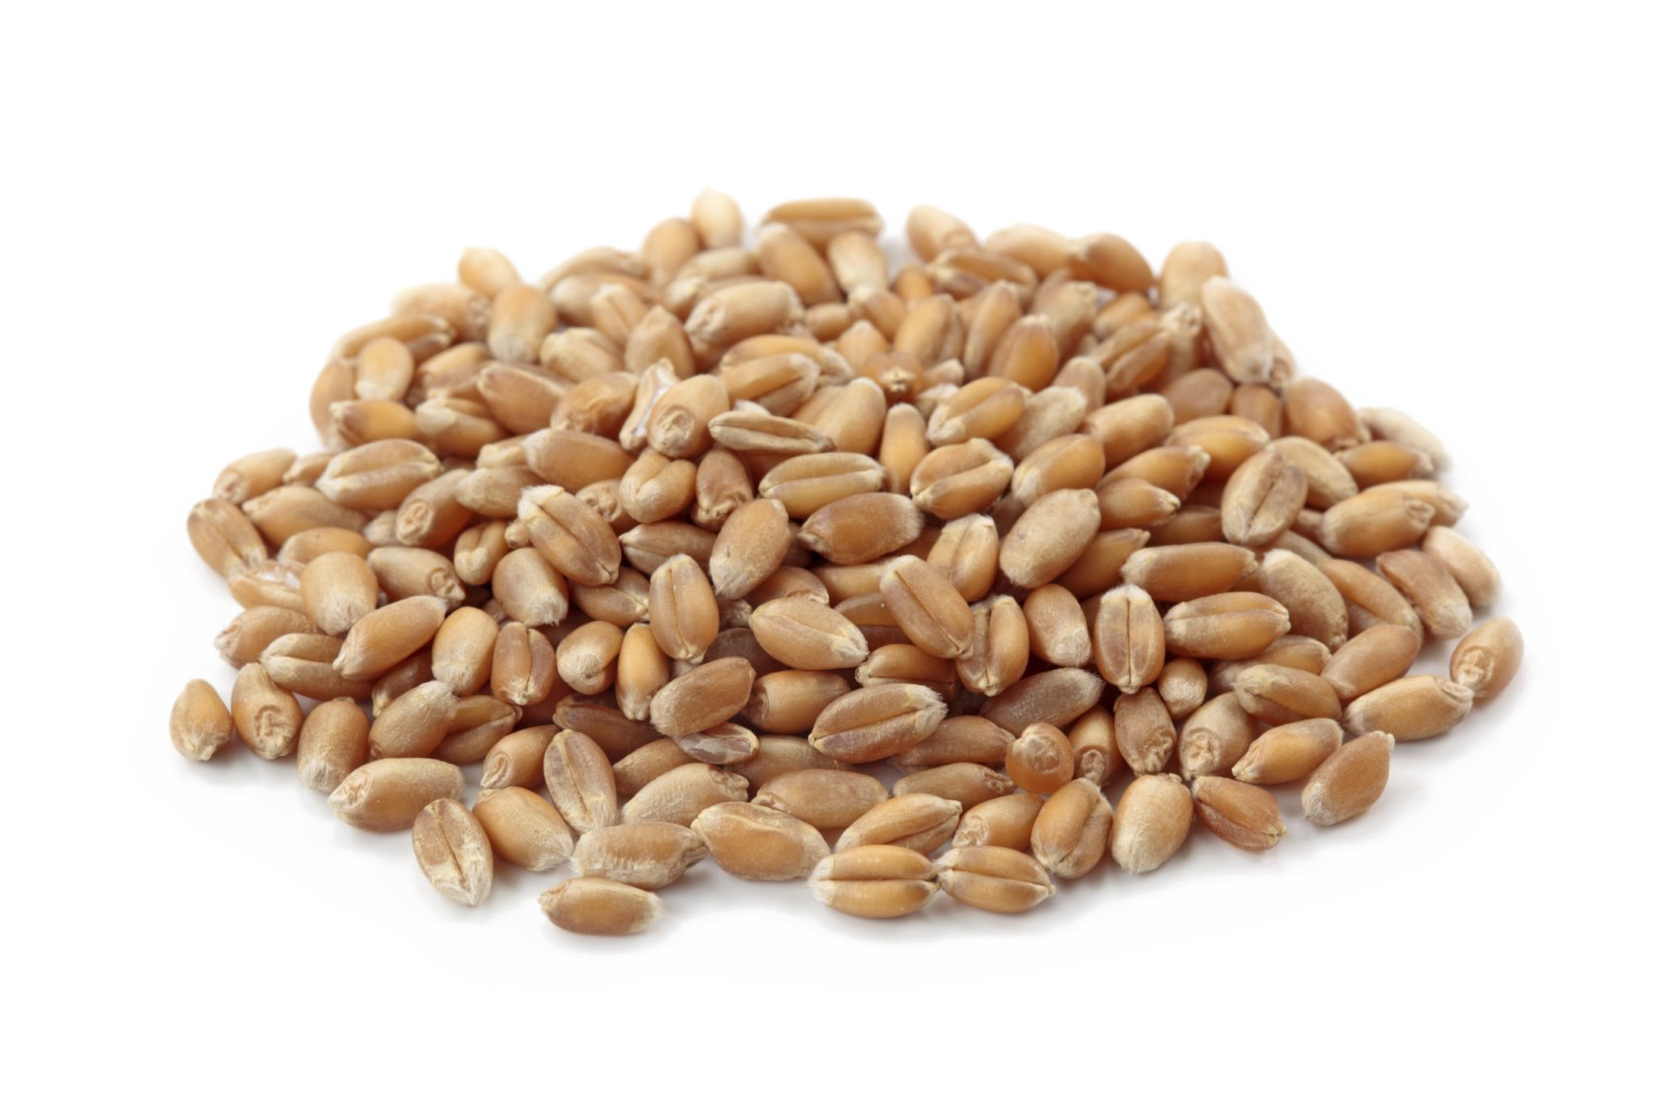
The lifecycle of garden seeds
Blackstone Valley Veggie Gardens Sustainability Series
Plant
Harvest
Store

Slide 3
Before you plant
Know your “Hardiness Zone”. (6a here in Blackstone, Ma)
A hardiness zone is a geographic area defined to encompass a certain range of climatic conditions relevant to plant growth. It is the original and most widely used system, developed by the United States Department of Agriculture (USDA) as a rough guide for landscaping and gardening.
Be certain that you know when to plant your seeds.
Cool weather crops
Warm weather crops
Realize your seed starting method
Indoors under lights
Winter milk jug sowing
Direct sowing

Slide 4
Zone 6 gardening seed schedule

Slide 5
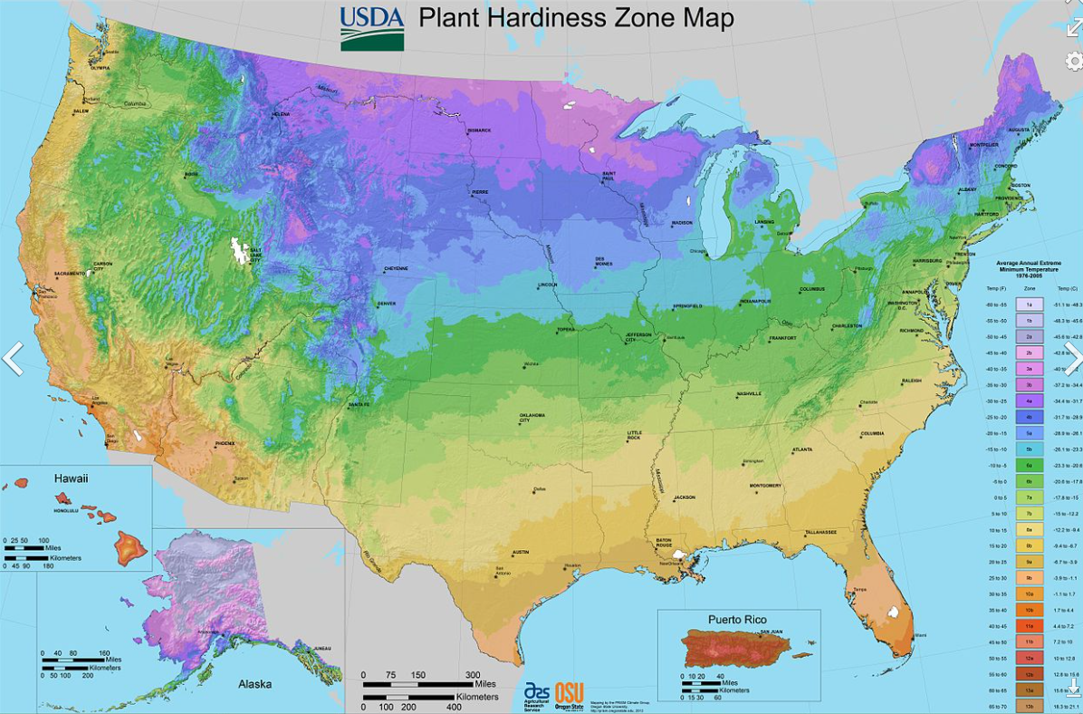
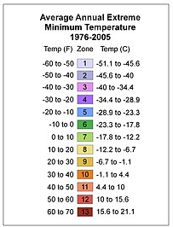
USDA Hardiness map

Slide 6
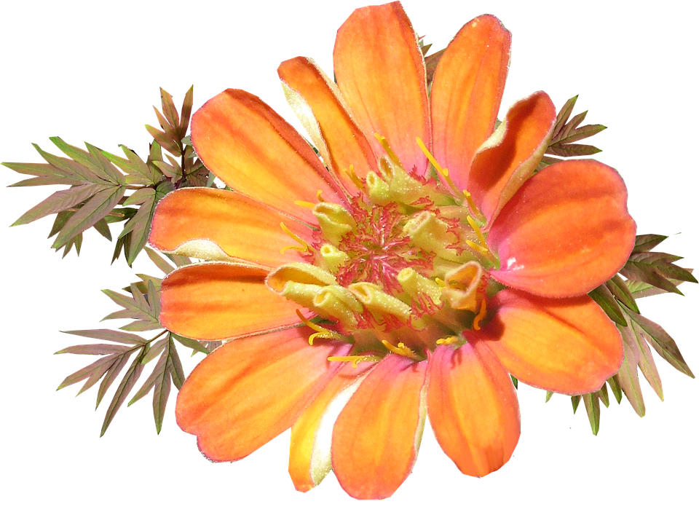
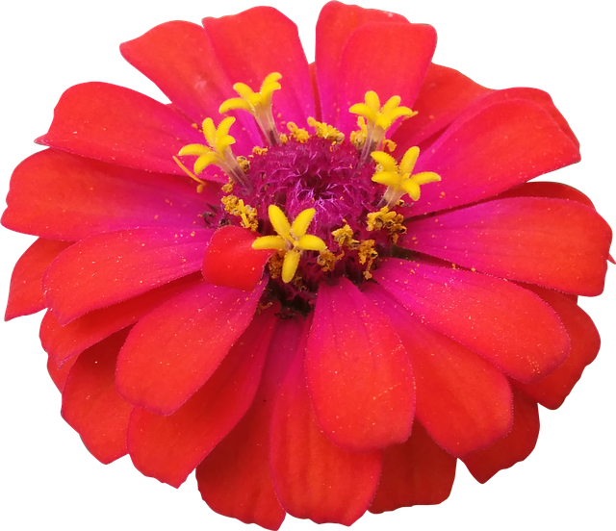
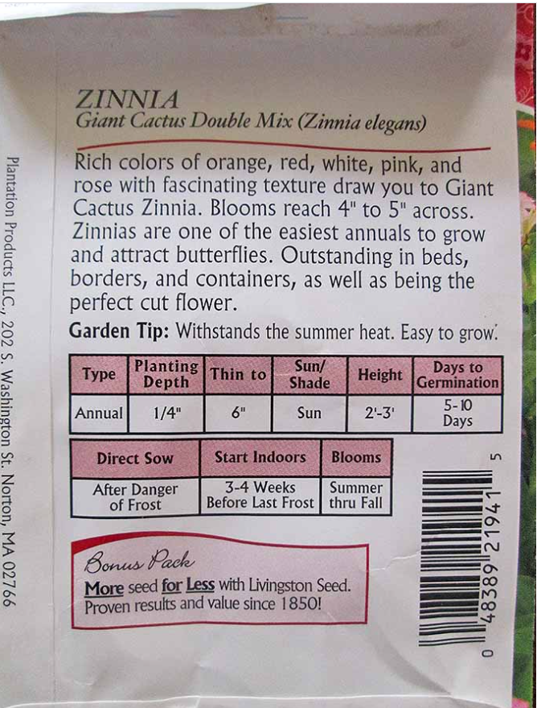
Reading your seed package
Plant Name in English
Latin Name
Description
Type – Annual or Perennial
Planting Depth—important
Thin to –Distance between plants
Sun/Shade
*Start Indoors—needs hardiness zone
Blooms—for flowering plants
Zone | Last Frost Date | First Frost Date
6 | April 1-21 | October 17-31
*

Slide 7
Winter Sowing (Also known as milk jug sowing)
Find a Suitable Container
Poke Holes in the Bottom of the Container
Cut Open the Container
Add Soil.
Plant Your Seeds.
Add Water.
Use Duct Tape to Seal the Container.
Label the container
Put your jug outside

Slide 8
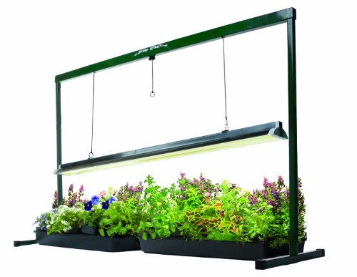
Indoor Seed starting.
Set up a lighted seed starting area
Gather growing containers to start your seedling
Prepare your seed starting soil
Sow your seeds
Keep soil moist but not soggy
Begin fertilizing the seedlings once true leaves sprout
Thin the plants so the strongest survive (Harden your plants)
Pot up the seedlings to larger containers
Adapt your seedlings to outdoors:
Transplant your seedlings to the garden:

Slide 9
Sowing methods
Tomatoes, Eggplant and Peppers (nightshades) can not be direct sown because our soil warms too late in the season. They are best started indoors under lights.
Kale, Cabbage, Cauliflower, Broccoli and Brussel Sprouts (brassicas) can be started under lights or started using the milk jug method. If you use the milk jug method your plants will start of smaller but will catch up soon and be hardy. No need to harden off.
Carrot, Beet, Turnip (root veggies) should be direct-sown so the roots are not disturbed.
Peas and Beans (legumes) should be direct sown
Melon, Cucumbers, Squash and Corn can be direct sown or started indoors. Sometimes they get too big and hard to keep indoors.
Spinach, Chard and Arugula can be grown using any method.
Which plants did I forget to mention?

Slide 10
Harvesting seed—Cross Pollination matrix
Vegetable Crop | Plant Lifecycle | Will Cross-Pollinate With
Beans | Annual | Self-pollinating; very small chance of different species
Beets | Biennial grown as an Annual. | Readily crosses with any Beta vulgaris species: Swiss chard,
Broccoli | Biennial grown as an Annual. | Readily crosses with any Brassica oleracea species: Cauliflower, Cabbage, kale, brussels sprouts, kohlrabi, romanesco broccoli, kale, collard greens, broccoli
Brussels Sprouts | Biennial grown as an Annual. | See: Broccoli
Carrot | Biennial grown as an Annual. | Queen Anne’s Lace, and any subspecies of Daucus carota
Cabbage | Biennial grown as an Annual. | See: Broccoli
Cauliflower | Biennial grown as an Annual. | See: Broccoli
Corn | Annual | Cross pollinates with other varieties for the 1st year crop.
Cucumber | Annual | Will cross pollinated with other cucumber varieties. Please note: it is a commonly held belief that cucumbers will cross with squash and melons. This is false.
Eggplant | Annual | Self-fertilizing
Garlic | Annual | Self-fertilizing
Melons | Annual | Cucumis melo species will cross pollinate; honeydew, cantaloupe, canary melon, etc. Please note that they will not cross-pollinate with watermelons and cucumbers.

Slide 11
Cross pollination matrix
Vegetable Crop | Plant Lifecycle | Will Cross-Pollinate With
Onion | Biennial | Note: onions will not cross-pollinate with leeks or chives. Bunching onions and bulb onions can cross-pollinate, although this is extremely rare.
Pea | Annual | Self-pollinating
Pepper | Annual | Hot peppers and sweet peppers will cross-pollinate
Potato | Perennial Grown as Annual | Propagated by tuber; cross-pollination isn’t an issue. (if you are propagating by seed, all varieties will cross with each other)
Radish | Annual | Daikon
Spinach | Annual | With other spinach
Squash | Annual | Cucurbita maxima, C. mixta, C. pepo, and C. moschata will all cross-pollinate
Tomato | Annual | Self-fertilizing
Tomatillo | Annual | Require cross-pollination for fruit, plant one variety at a time to ensure seed purity. Will not cross-pollinate with tomatoes (this is a myth).
Watermelon | Annual | Citron; will not cross-pollinate with other melon varieties.

Slide 12
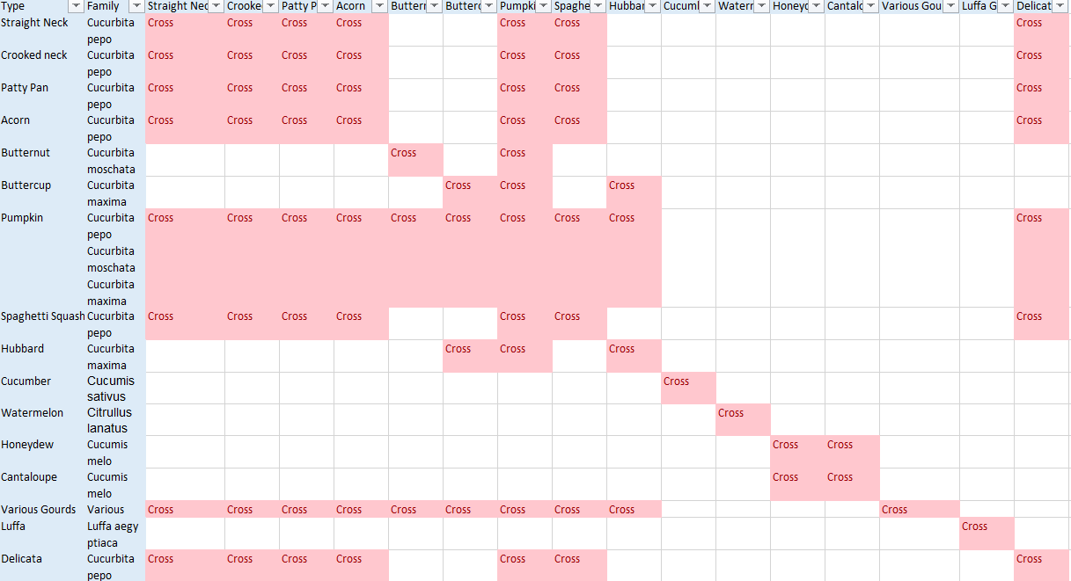
Cross-pollination cucurbits(squash, melon and cuke)

Slide 13
Cross pollination of brassicas (cabbage family)

Slide 14
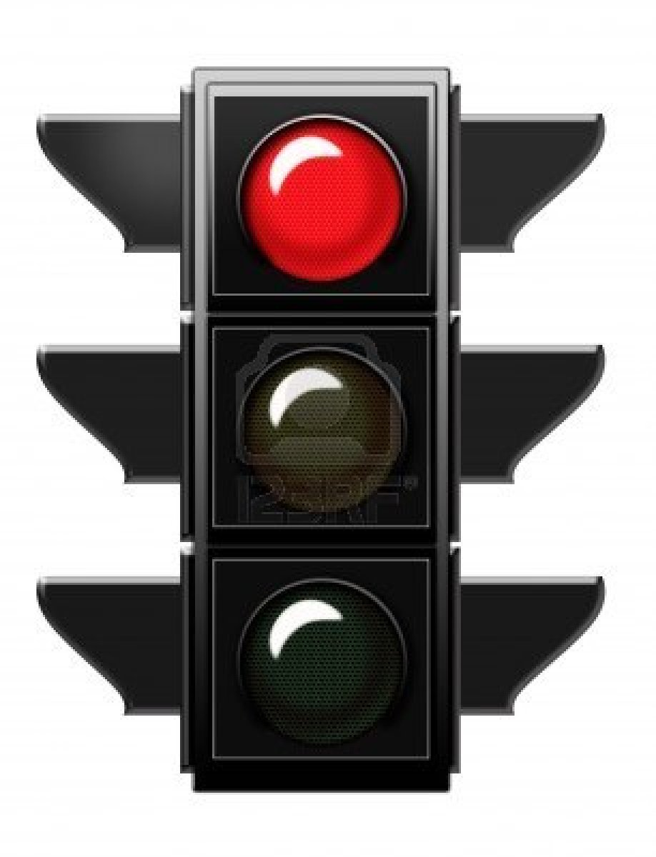
Heirloom seeds
WHAT IS AN HEIRLOOM PLANT? ←SAVE THESE SEEDS
Heirloom varieties are open-pollinated--meaning that unlike hybrids, seeds you collect from one year will produce plants with most of the characteristics of the parent plant. ... Many heirloom varieties were preserved by home gardeners who saved seed from their family gardens from year to year.
WHAT IS A HYBRID PLANT? ←DO NOT SAVE THESE SEEDS
In agriculture and gardening, hybrid seed is produced by cross-pollinated plants. ... Hybrids are chosen to improve the characteristics of the resulting plants, such as better yield, greater uniformity, improved color, disease resistance. An important factor is the heterosis or combining ability of the parent plants.

Slide 15
When and how to harvest seed
Know When Your Seeds Are Mature
For crops that produce wet fruits, the seeds are not always mature when the fruits are ready to eat. Eggplant, cucumber, and summer squash fruit are eaten when the fruits are immature and still edible, but before the seeds are actually mature. This means that seed savers need to leave a few fruits to fully mature in the garden when they want to save seeds. Dry fruited crops, like grains, lettuce, and beans, can be removed from the plant once seeds are dry and hard.
Know How To Harvest Seeds
Garden crops can be classified as either dry fruited or wet fruited. Collecting seeds from dry fruited crops, can be as simple as going out to the garden, handpicking a few mature seedpods, and bringing them into the house for further drying and cleaning. Fruits from wet fruited crops must be picked when their seeds are mature. The harvested fruits are either crushed or cut open, and the seeds are extracted from the flesh and pulp before the seeds are dried.

Slide 16
Harvesting cucumber seed

Slide 17
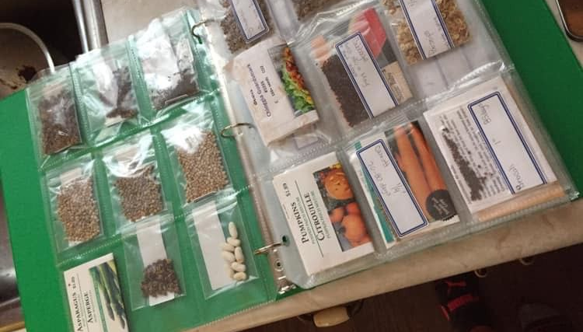
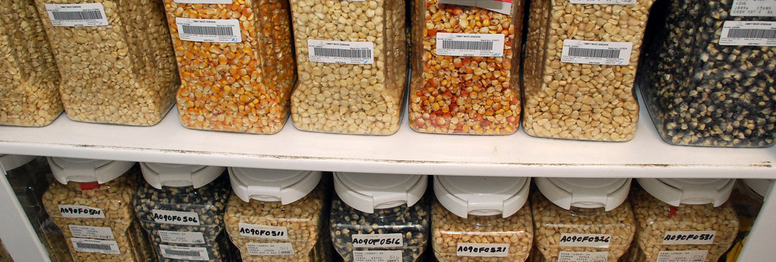
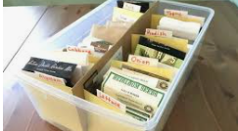
Storing seeds
The secret to successful seed storage is “cool and dry.” As soon as your seeds arrive, store them immediately in an airtight container in a cool spot, away from any obvious heat source, and out of the sunlight.

Slide 18
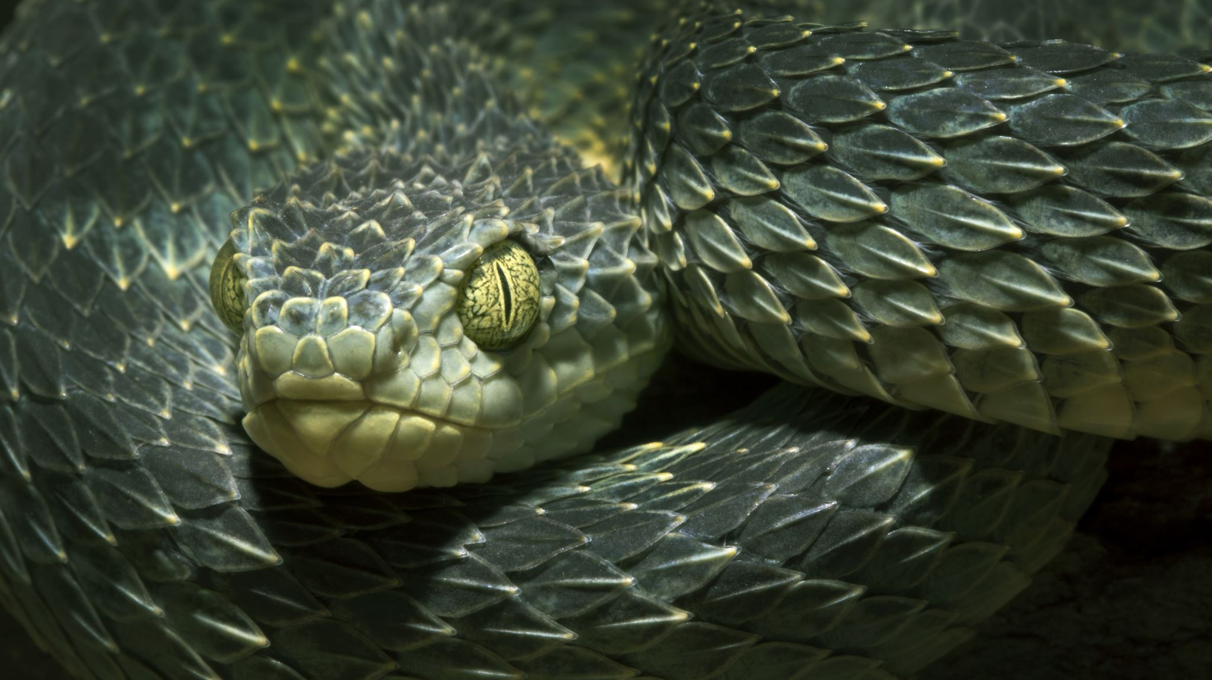
How long do seeds last
Vegetable | Years | Vegetable | Years
Asparagus | 3 | Kohlrabi | 3
Bean | 3 | Leek | 2
Beet | 4 | Lettuce | 6
Broccoli | 3 | Muskmelon | 5
Brussels sprouts | 4 | Mustard | 4
Cabbage | 4 | New Zealand spinach | 3
Carrot | 3 | Okra | 2
Celeriac | 3 | Onion | 1
Cauliflower | 4 | Parsley | 1
Celery | 3 | Parsnip | 1
Chard, Swiss | 4 | Pea | 3
Chicory | 4 | Pepper | 2
Chinese cabbage | 3 | Pumpkin | 4
Collards | 5 | Radish | 5
Corn, sweet | 2 | Rutabaga | 4
Cucumber | 5 | Salsify | 1
Eggplant | 4 | Spinach | 3
Endive | 5 | Squash | 4
Fennel | 4 | Tomato | 4
Kale | 4 | Turnip | 4
 |  | Watermelon | 4

Slide 19
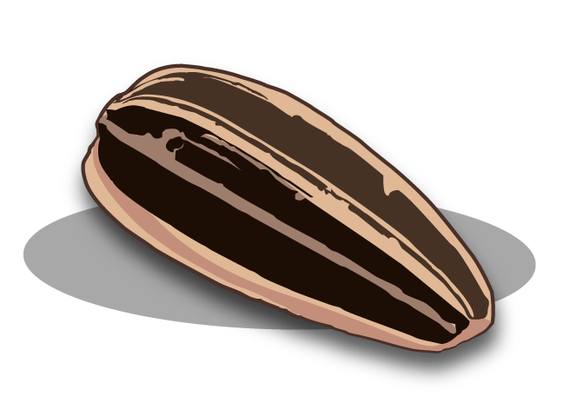
Questions?

